Slide 1
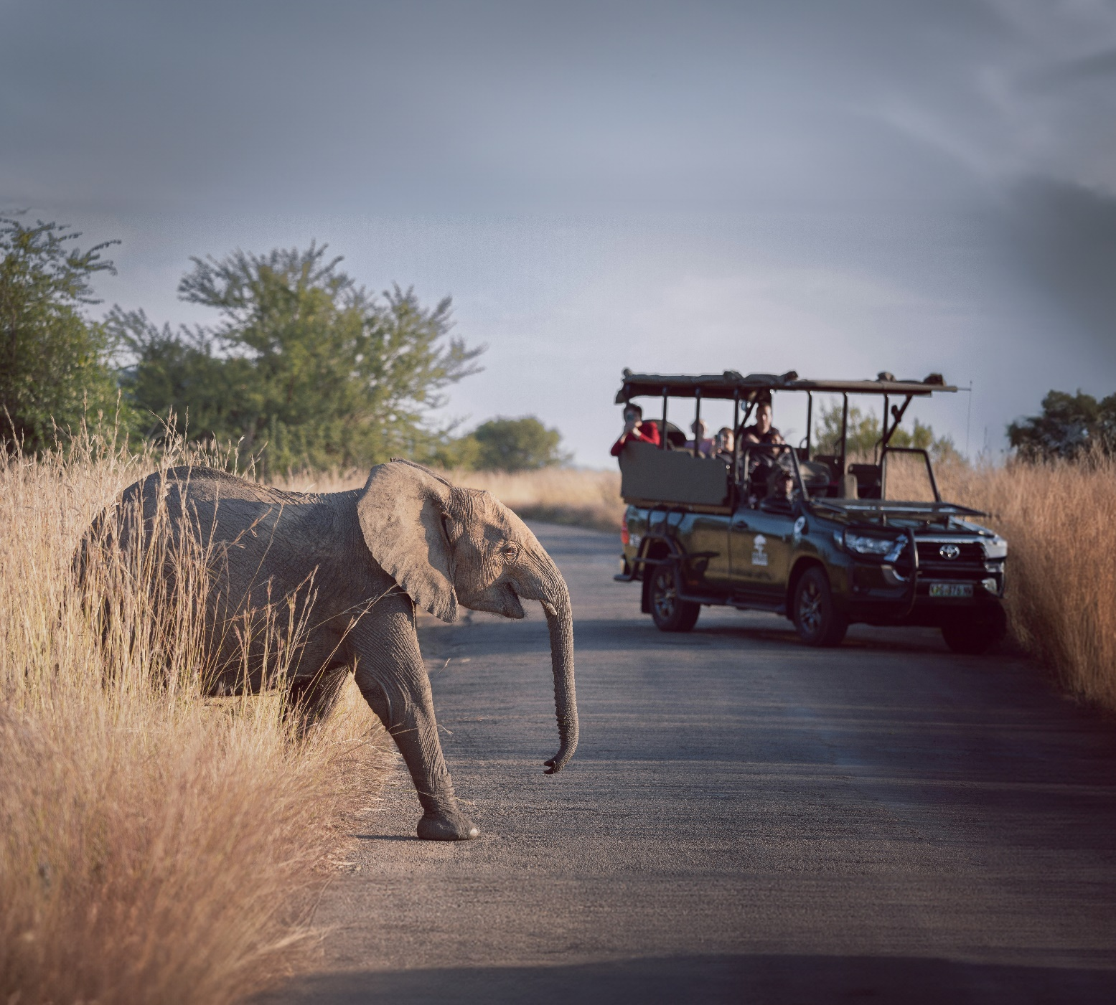
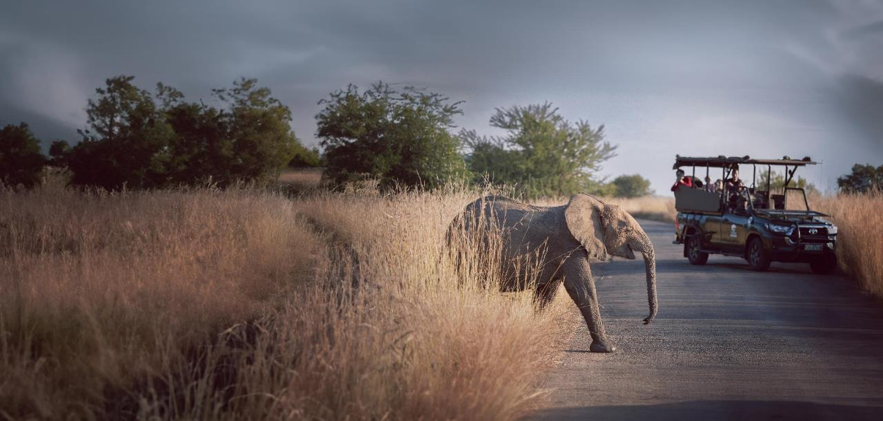



Sub-national environmental accounts in South Africa: Accounts for Protected Areas
Sub-national Statistics Sprint
1 October 2015
Dr Bokang Vumbukani-Lepolesa
Chief Director: National Accounts

Slide 2

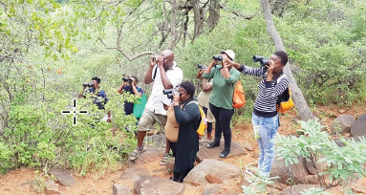


Contents
Background
    Why experimental estimates?
    Natural Capital Accounting journey in South Africa
    Statistics South Africa’s Natural Capital series.
An example of sub-national natural capital accounts in South Africa
Key lessons

Slide 3
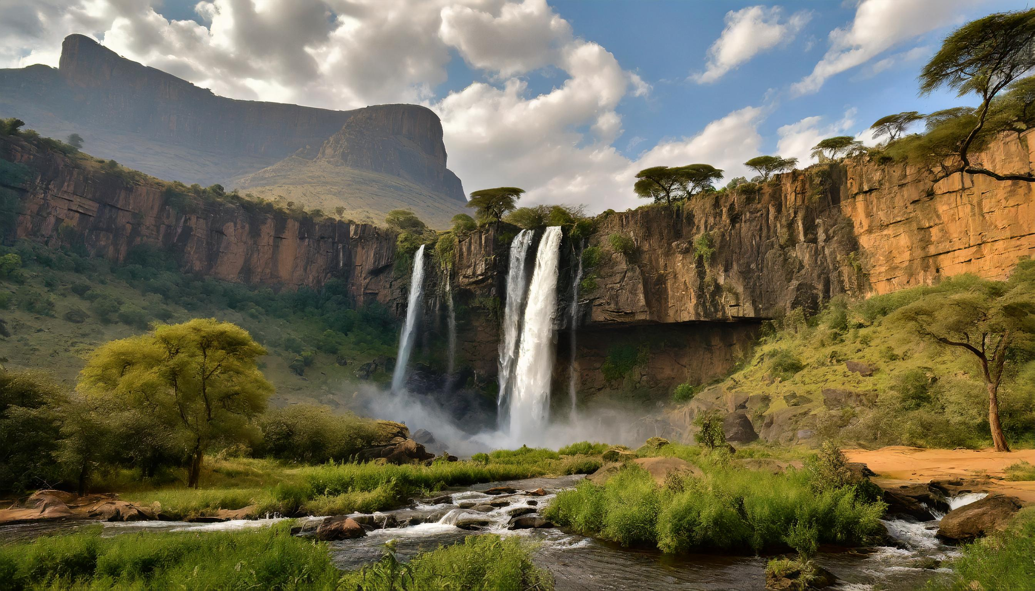
Background

Slide 4

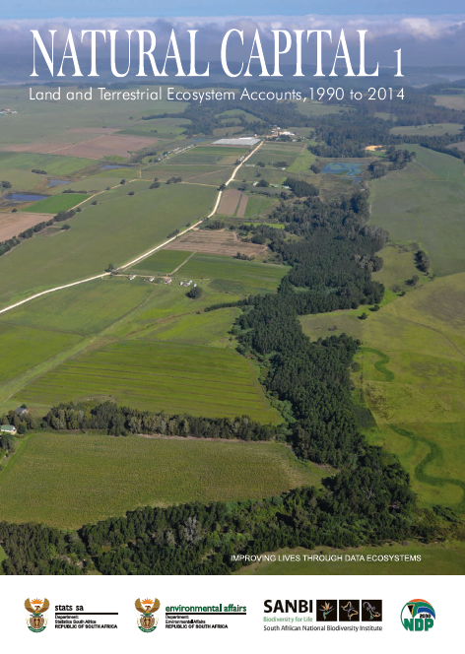
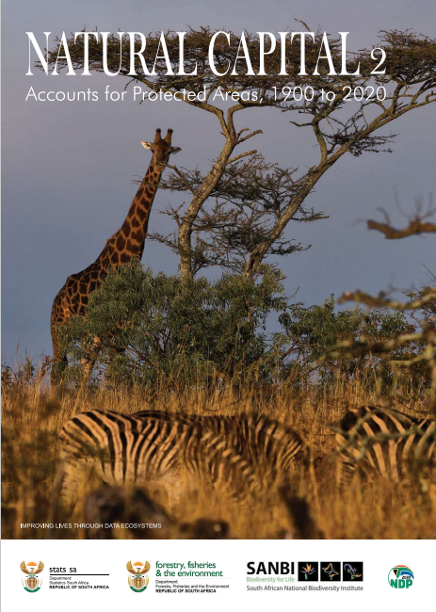
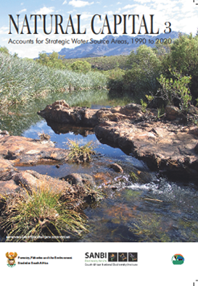

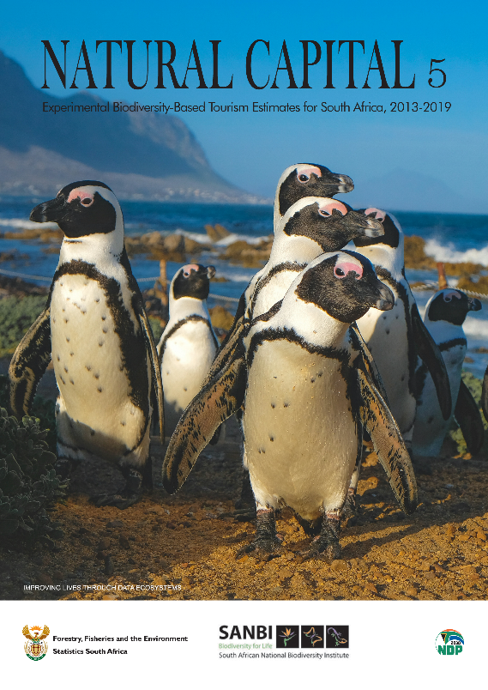
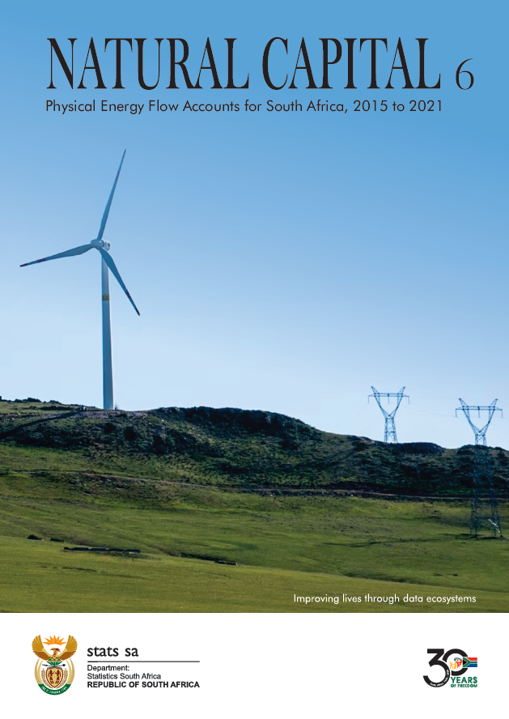
Why experimental estimates in South Africa?
Experimental estimates address the need for data on environmental economic accounts in policy development and decision making.
A gap in the official statistics on natural resources and ecosystem services

Slide 5
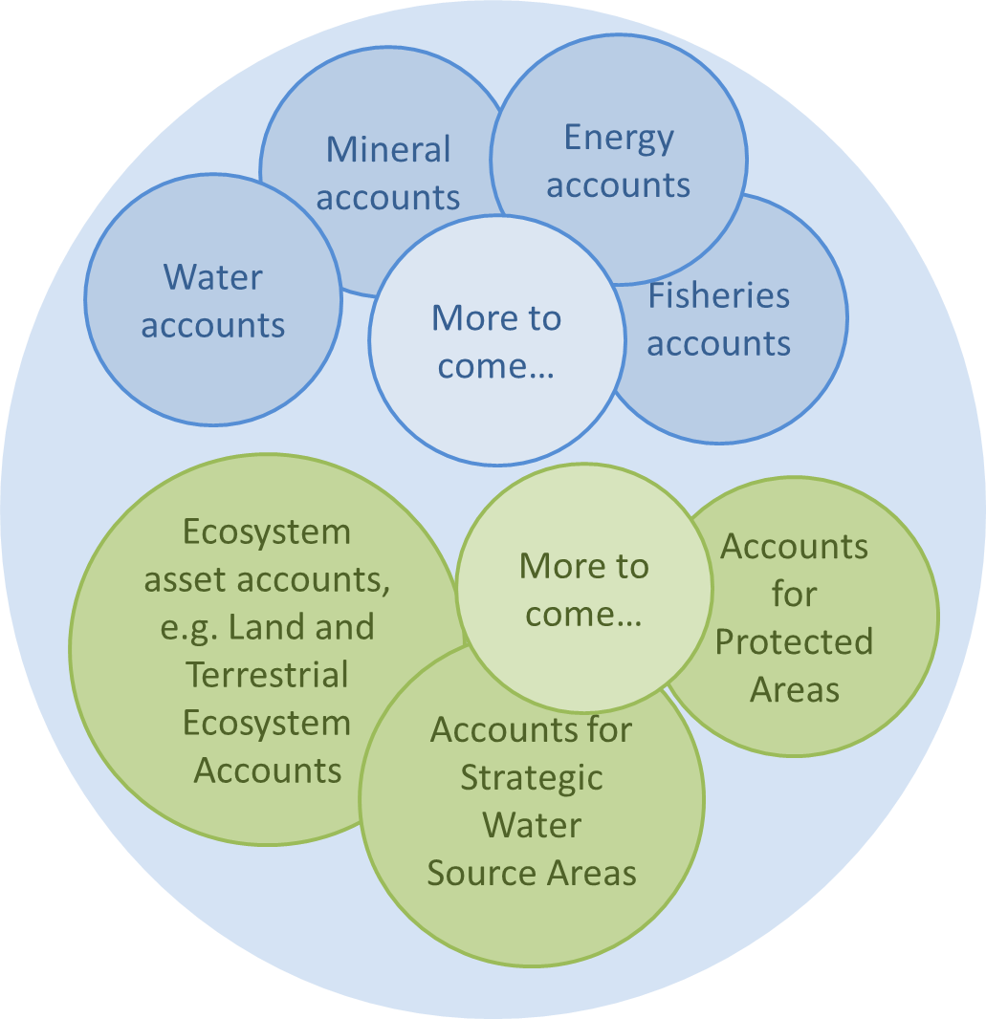
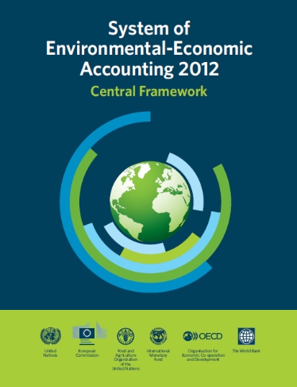
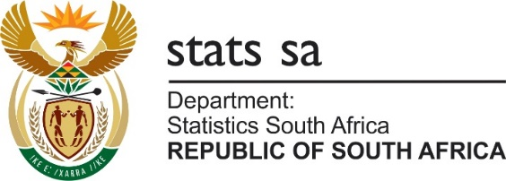










Natural Capital Accounting in South Africa is done through collaboration

Slide 6
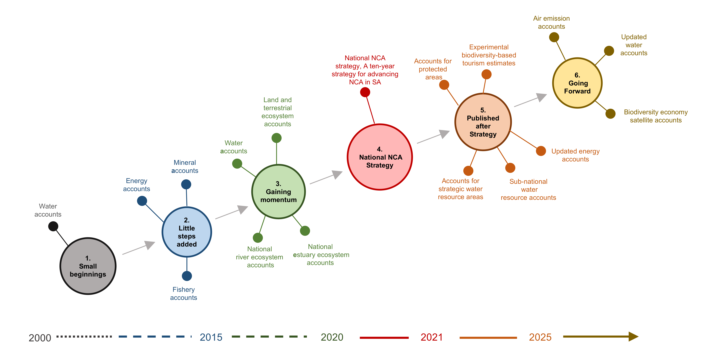
Natural Capital Accounting journey in South Africa
NCA measures SA’s wealth of land, water, minerals, ecosystems, biodiversity and ecological infrastructure
From early beginnings with national water accounts in 2000, momentum has grown.
Since 2014, donor funded projects have helped to increase capacity, especially for ecosystem accounting.
Country capacity
NCAVES Project
Country capacity
ANCA Project
EI4WS Project
Future Donor Project(s)

Slide 7


Stats SA’s Natural Capital series
Land and Terrestrial Ecosystem Accounts, 1990 to 2014: Released in December 2020
Accounts for Protected Areas, 1900 to 2020: Released in October 2021
Accounts for Strategic Water Source Areas, 1990 to 2020: Released in March 2023
1
2
3
Notes:
Stats SA is proud to have launched a new Natural Capital series, dedicated to natural capital accounts.
The new Natural Capital series was launched in December 2020 with the first national Land and Terrestrial Ecosystem Accounts, 1990 to 2014
The Accounts for Protected Areas, 1900 to 2020 was the second publication in the Natural Capital series (released in October 2021).
Key indicators are identified in each account, with consideration of the relevance of the information likely to support evidence-based policy and decision-making
We anticipate that the series will go from strength to strength in the years to come, providing credible information to support government and civil society in meeting South Africa’s development challenges

Slide 8
Stats SA’s Natural Capital series
Sub-national Water Resource Accounts, 2015 to 2021: Released in March 2024
Experimental Biodiversity-Based Tourism Estimates, 2013 to 2019: Released in June 2024
Physical Energy Flow Accounts for South Africa, 2015 to 2021: Released in March 2025
5
3
4
6
Notes:
Stats SA is proud to have launched a new Natural Capital series, dedicated to natural capital accounts.
The new Natural Capital series was launched in December 2020 with the first national Land and Terrestrial Ecosystem Accounts, 1990 to 2014
The Accounts for Protected Areas, 1900 to 2020 was the second publication in the Natural Capital series (released in October 2021).
Key indicators are identified in each account, with consideration of the relevance of the information likely to support evidence-based policy and decision-making
We anticipate that the series will go from strength to strength in the years to come, providing credible information to support government and civil society in meeting South Africa’s development challenges

Slide 9
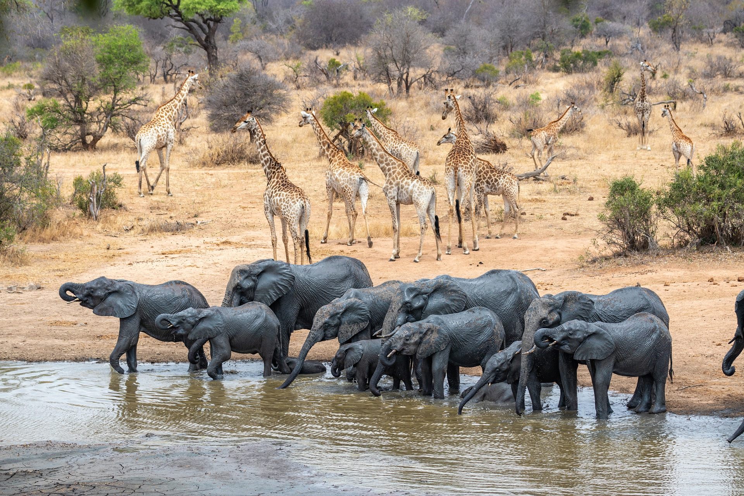
An example of sub-national natural experimental estimates
Accounts for Protected Areas

Slide 10
What are accounts for protected areas?
Protected areas:
  Areas of land or sea that are protected by law and managed primarily for biodiversity conservation.
  Can be declared on both private and communal land.
  Are not necessarily owned and managed by government.
The accounts track the expansion of the protected area estate at regular time steps over the period 1900 to 2020.
They are compiled at the national level, for provinces and for biomes, and are disaggregated by types of protected areas.
The accounts use information on the extent of protected areas and link this to information from the ecosystem extent account for terrestrial ecosystems published by Stats SA in 2020.

Slide 11
Types of protected areas
National Parks
Special Nature Reserves
World Heritage Sites
Nature Reserves
Mountain Catchment Areas
Forest Wilderness Areas
Forest Nature Reserves
Protected Environments
Types of protected areas

Slide 12
Key indicators from accounts for protected areas
By presenting information in a consistent, standardised accounting format, accounts can yield a range of indicators that can be applied in decision-making. Key indicators are:
Size of the protected area estate
Proportion of the country that is protected
Change in the size of the protected area estate
Composition of the protected area estate

Slide 13
Why are protected areas important?
Important for ecological sustainability and climate change adaption
Vital for conserving biodiversity
Serve as nodes in SA’s ecological infrastructure network
Support rural livelihoods and local economic development
Play a role in biodiversity tourism

Slide 14
The data source
The accounts use the South African Protected Area Database (SAPAD) as the spatial data inventory of protected areas in South Africa (Developed and maintained by DFFE).
The strength of the dataset: includes protected area names, types and declaration dates in a manner that provides a time series for accounts.
Limitations the dataset:
  incomplete information on land ownership in protected areas;
  Declaration dates for some protected areas or portions of protected areas in the dataset are absent and are still in the process of being determined and verified against the government gazette; and
  Does not include withdrawals of declaration.
Notwithstanding these limitations, the findings add to the richness of available information about protected areas.

Slide 15
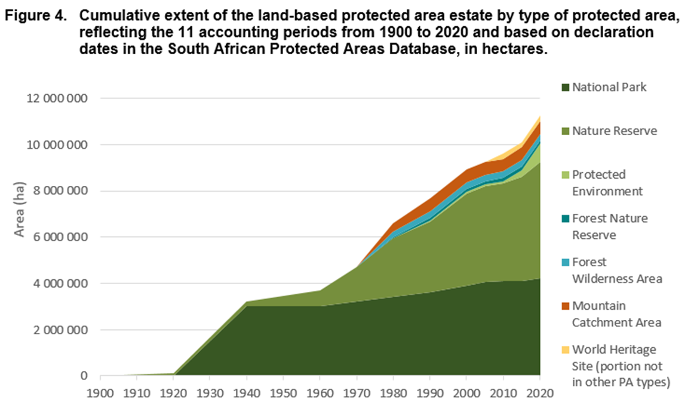
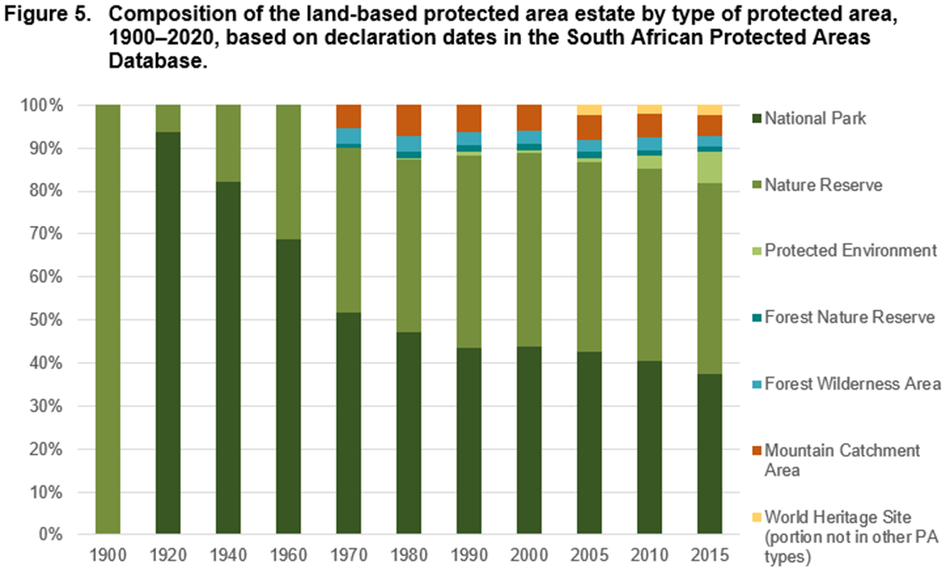
Key findings: National level

Slide 16
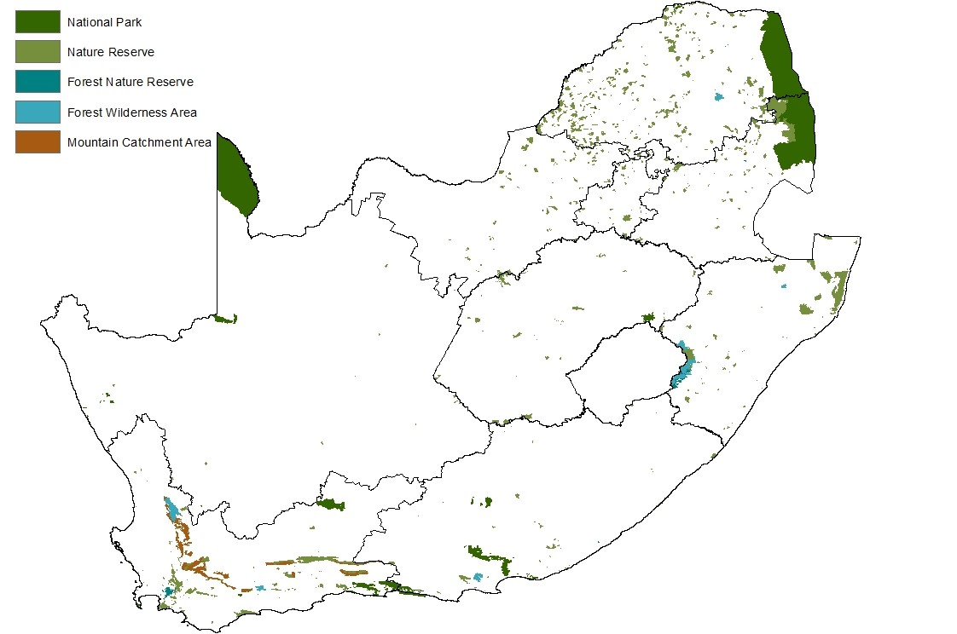
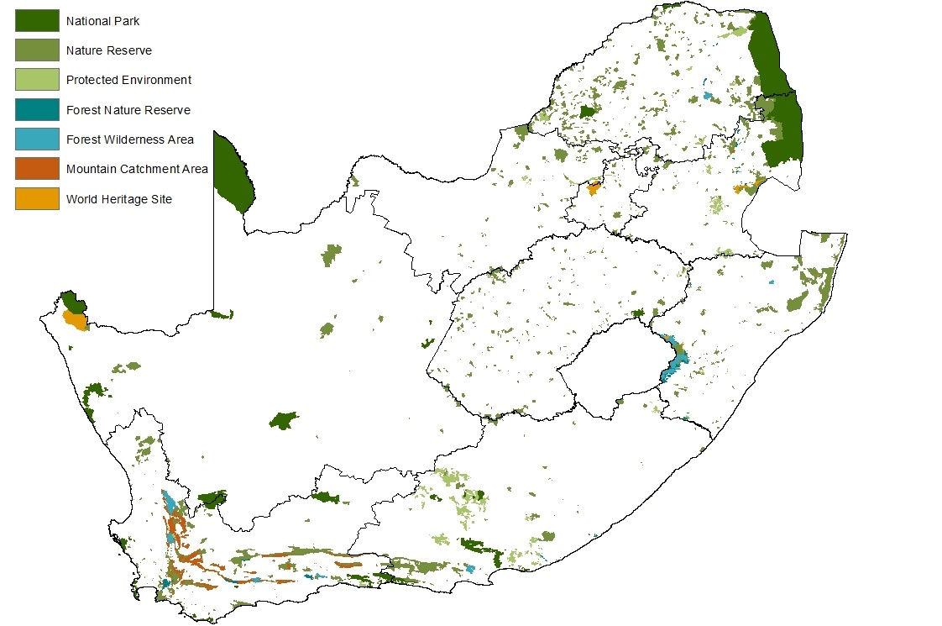
Key findings: National level
Land-based protected areas in 1980 and 2020
Based on declaration dates in South African Protected Areas Database
1980
5,4%
of the mainland
2020
9,2%
of the mainland

Slide 17
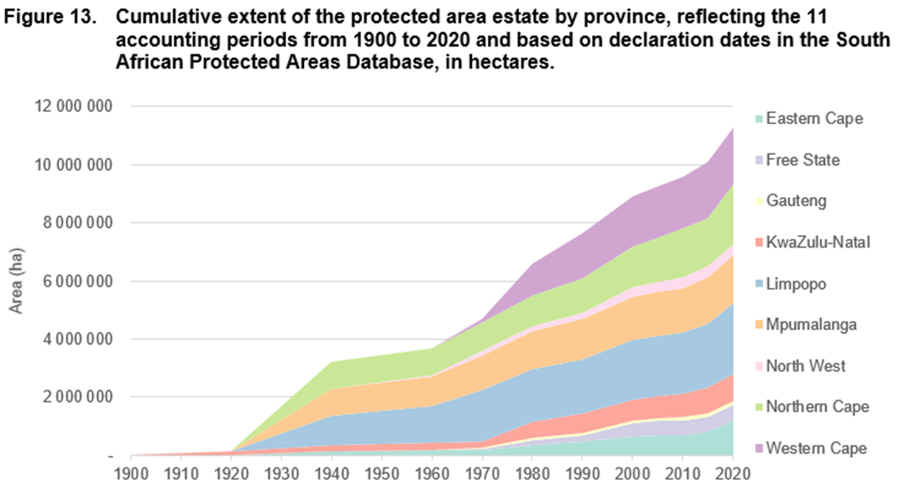
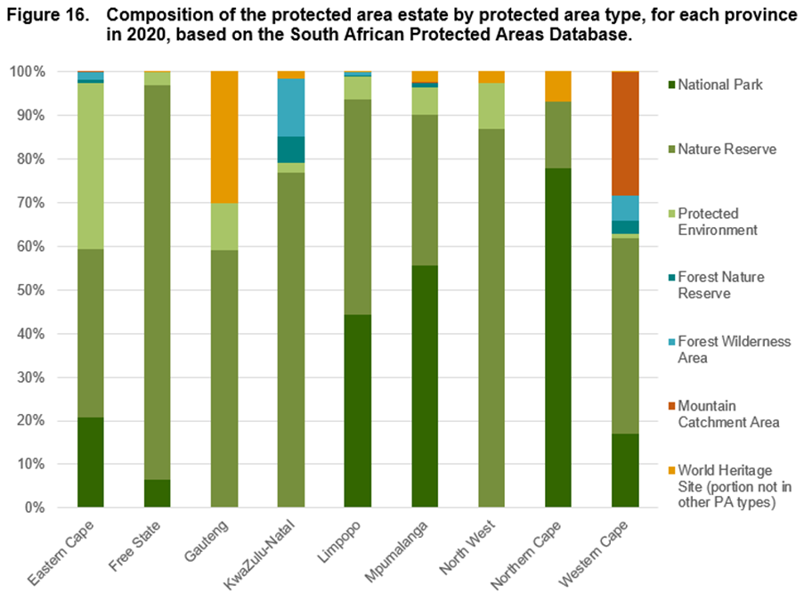
Key findings: Provincial level

Slide 18
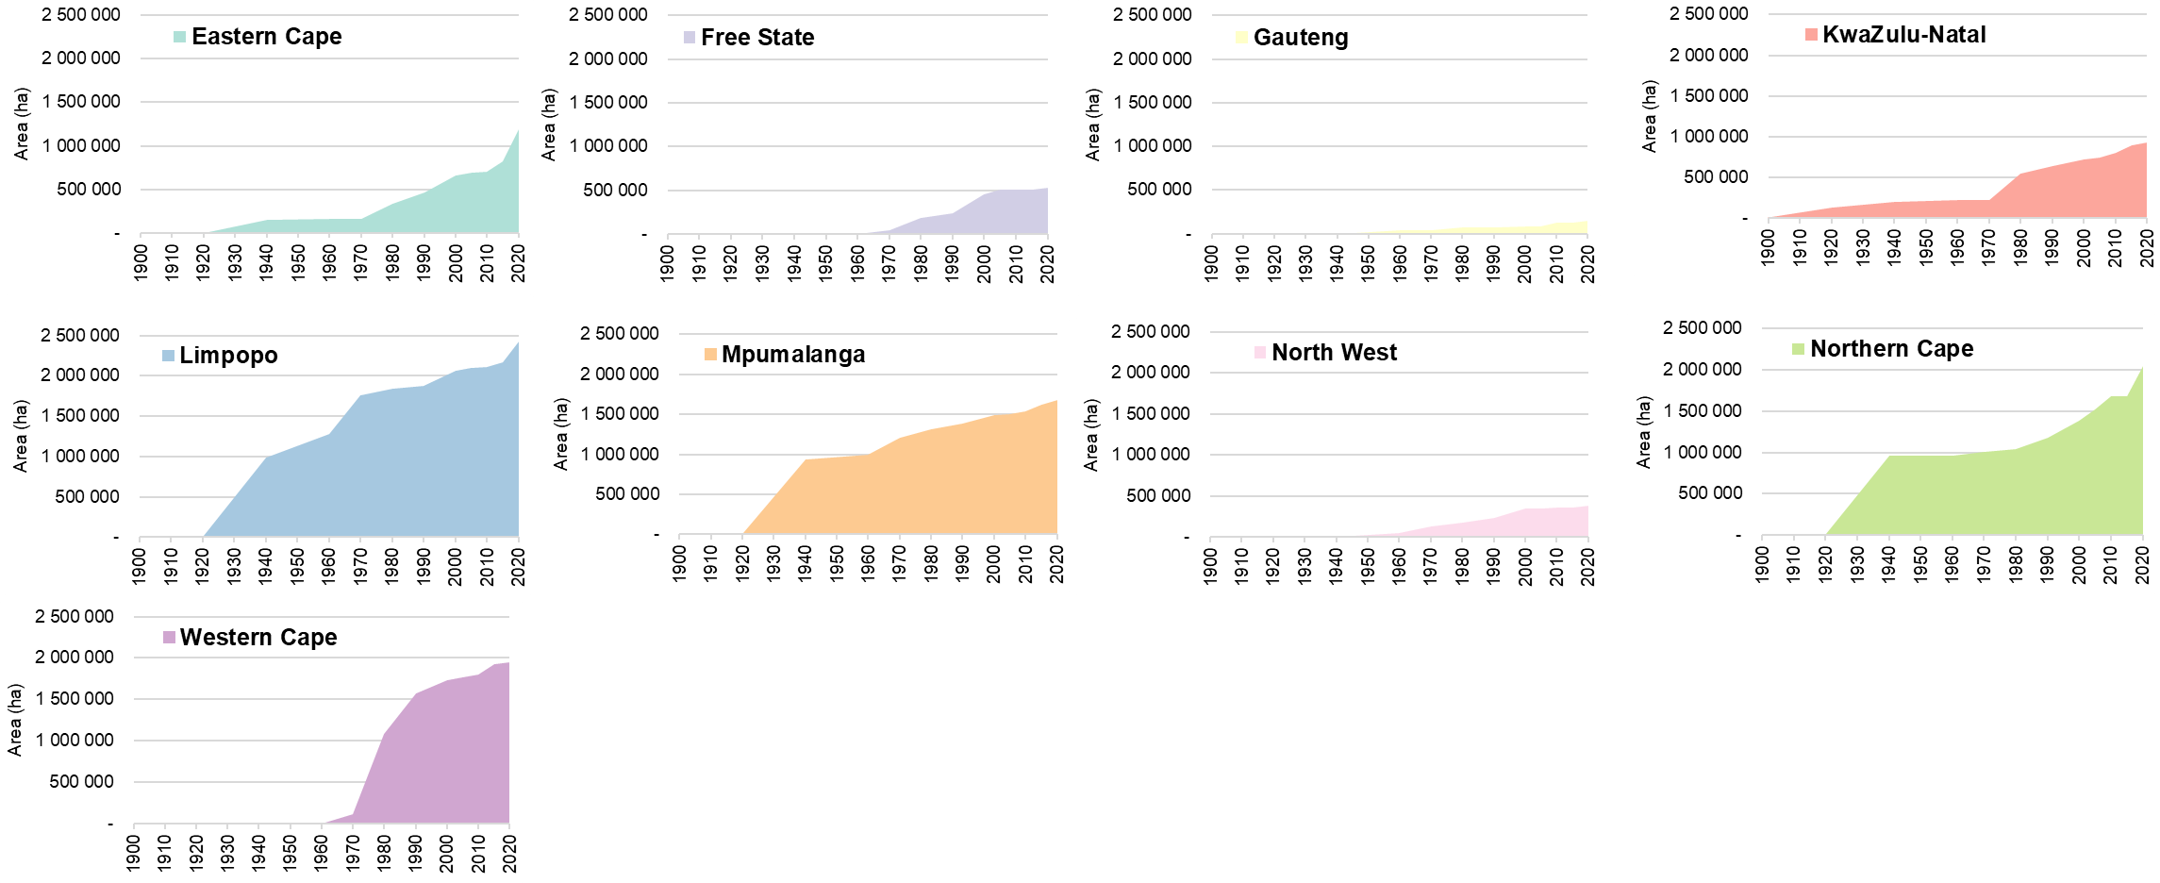
Key findings: Provincial level
Cumulative extent of the land-based protected area estate in each province

Slide 19
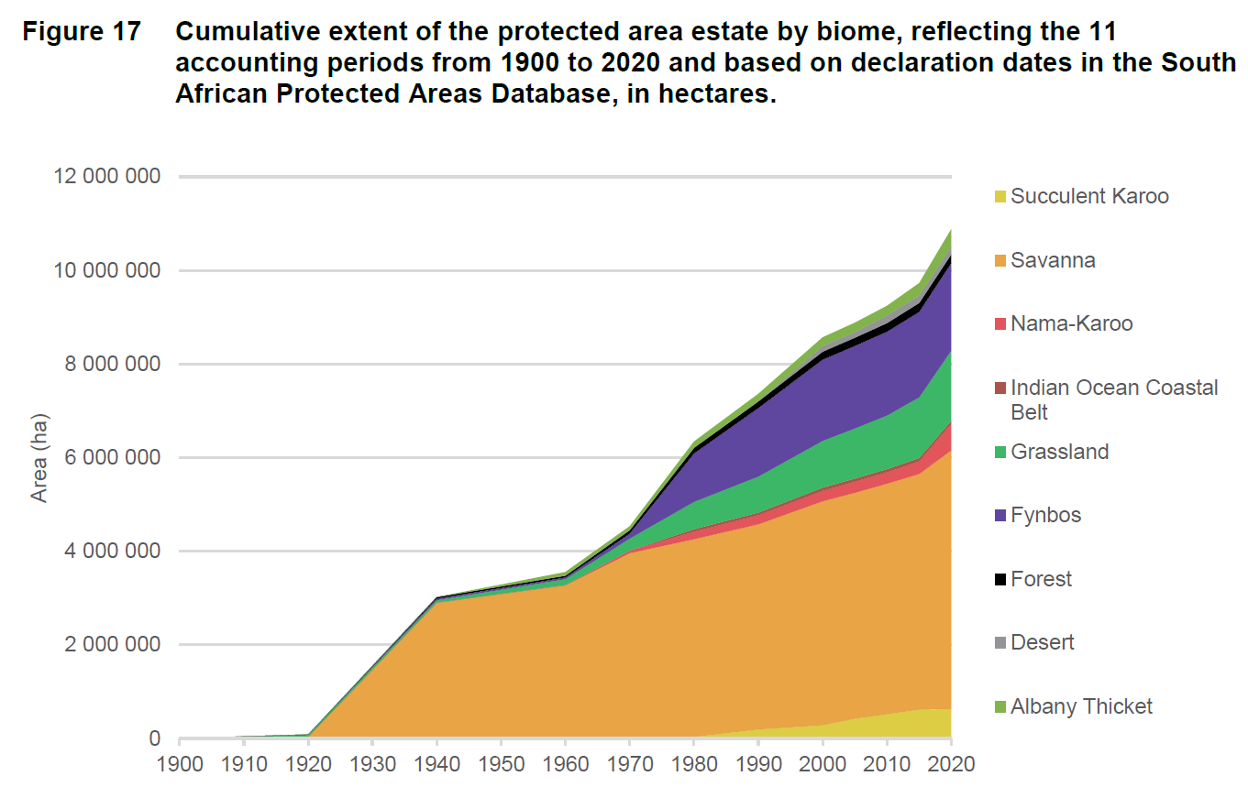
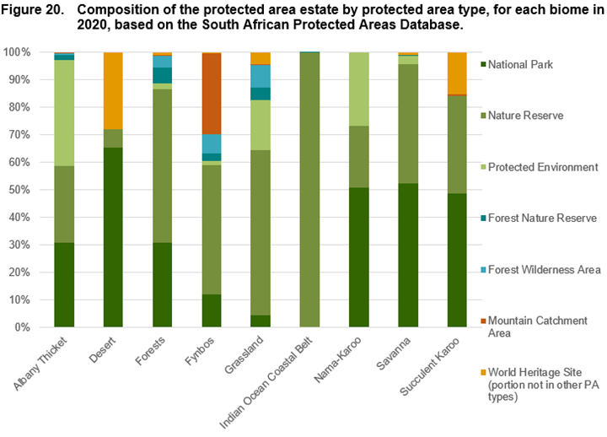
Key findings: Biome level

Slide 20
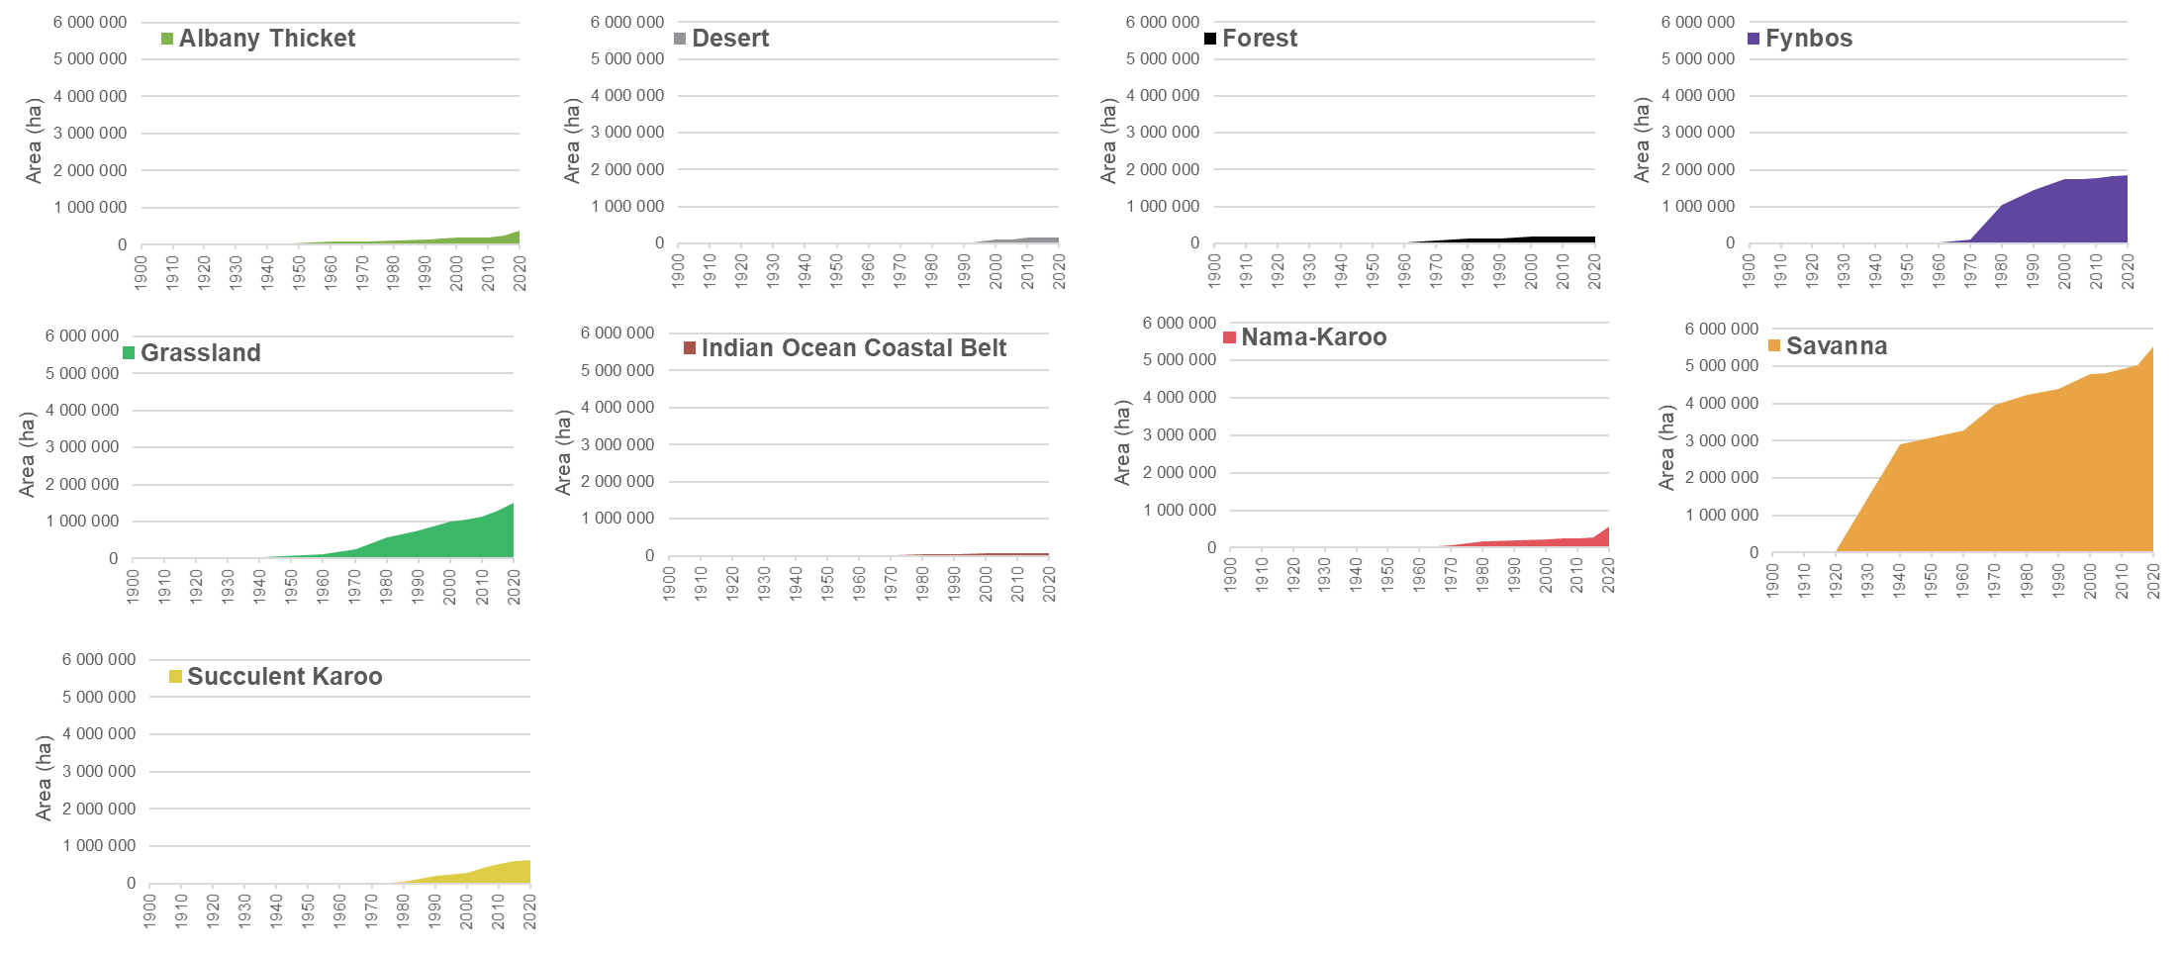
Key findings: Biome level
Cumulative extent of the land-based protected area estate in each biome

Slide 21
Directions for future work
Invest in improving the protected area dataset: Expand the accounts to include all realms
Who was included?
Link accounts for protected areas to land accounts
Who was included?
Explore additional accounts that could be developed for protected areas
Who was included?
Explore links to other social and economic data
Who was included?

Slide 22

Key lessons

Slide 23
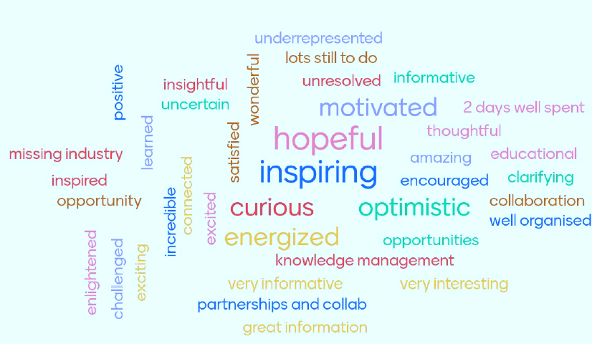
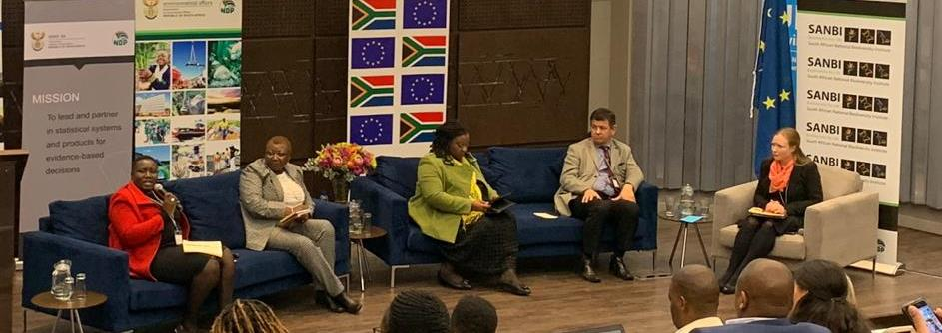
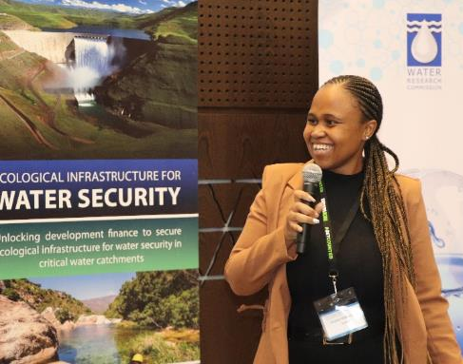
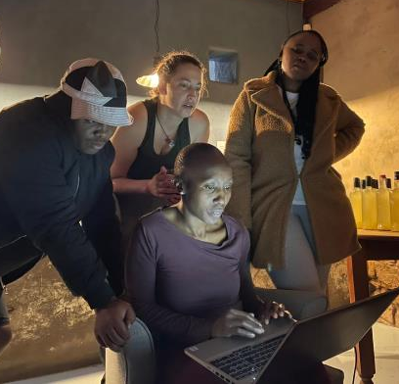
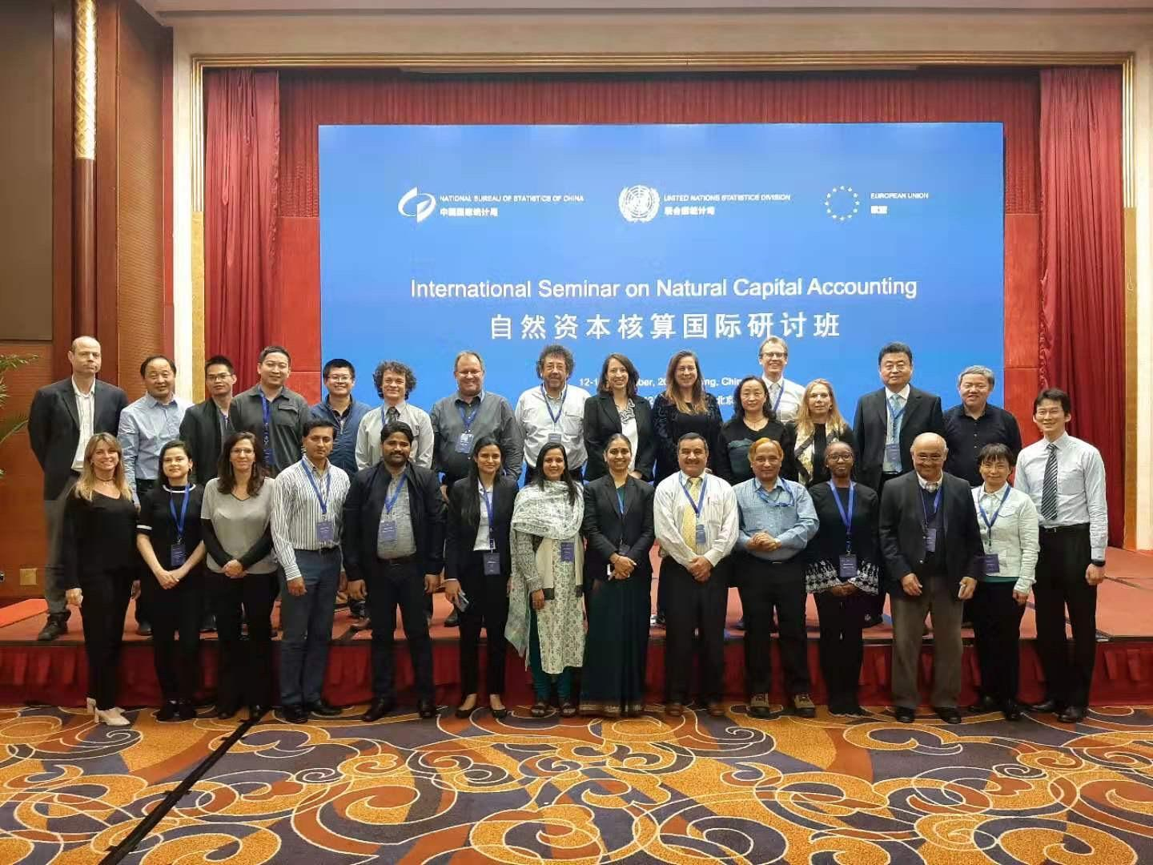
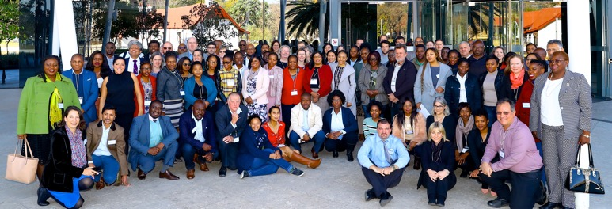
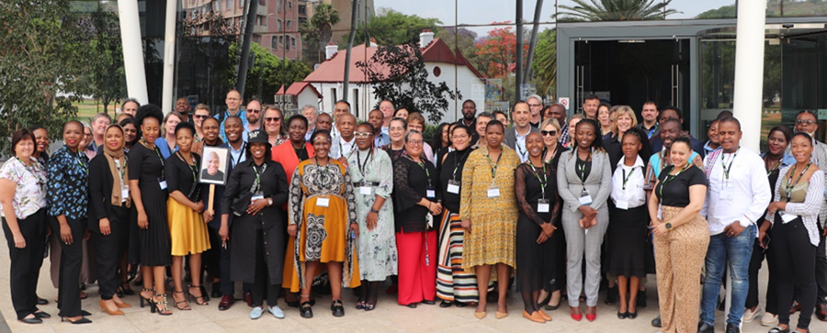
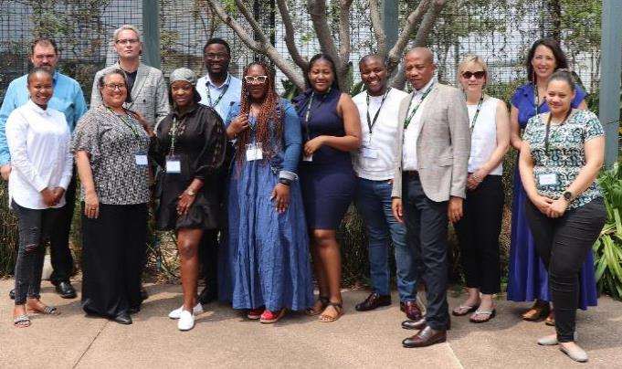
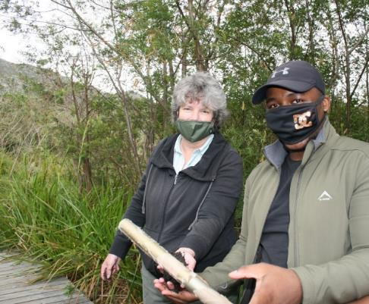
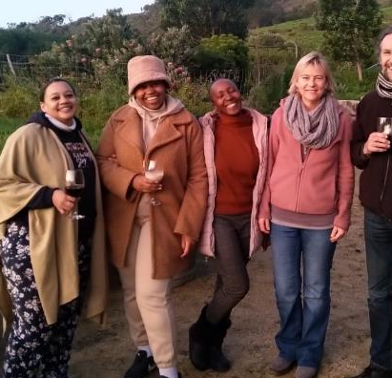
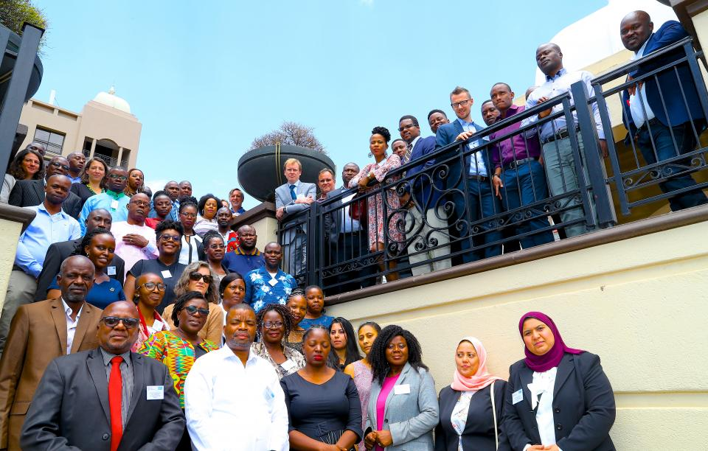
Putting attention to process makes a difference to impact
Technical process
Institutional process
Social process
Policy process

Slide 24
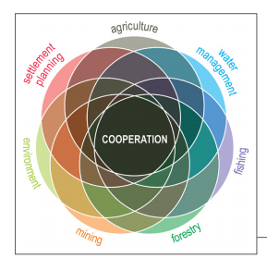

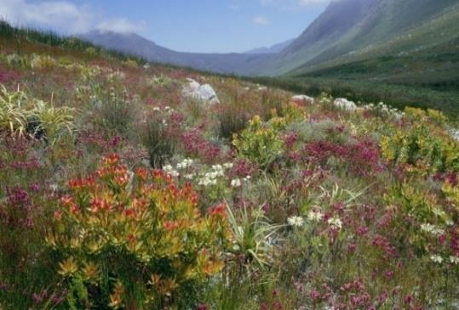
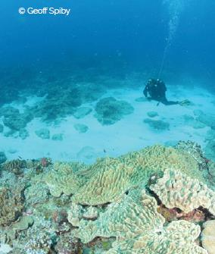
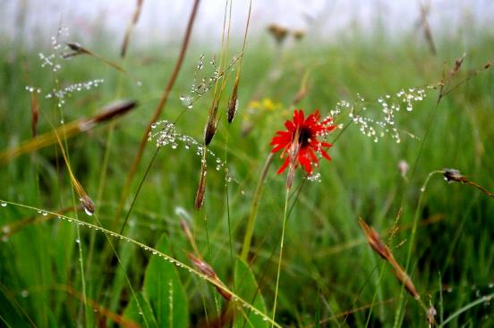
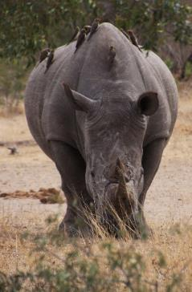

Building capacity and nurturing collaboration is key
NCA is catalysing new relationships and partnerships
Growing demand
Sustaining existing capacity and building capacity is a challenge (donor-funded, cost-containment in gov)
Sharing information regularly with regional and global CoP

Slide 25
Into the future – more sub-national natural capital accounts for South Africa?
Compilation of sub-national level accounts is a critical step for making natural capital information more relevant to local decision-making and planning.
There is a need to identify policy-relevant sub-national accounts priorities in the country – and include them more implicitly into the National Natural Capital Accounting Strategy review that will happen in 2026/2027 - A future roadmap for phased expansion.
Current sub-national accounts compiled for South Africa mostly focussed on ecosystems and biodiversity – SEEA Ecosystem Accounting.
Further explore how existing and future SEEA Central Framework accounts (stocks and flows of natural resources) could be disaggregated at a sub-national level in South Africa.
Pilot sub-national accounts for specific SEEA accounts and in specific regions in South Africa - test capacity and refine methodologies.
BUT any expansion of NCA in South Africa, and especially for more sub-national accounts, requires additional resources.

Slide 26
Thank you

